Slide 1
Adding and Subtracting Fractions with Common Denominators
Using Pictorial Representations

Slide 2
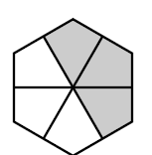
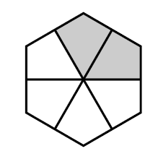
What is the sum of these fractions?
2
6
3
6

Slide 3
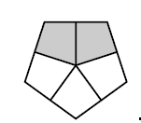
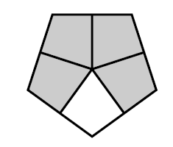
What is the sum of these fractions?
2
5
4
5
=
+

Slide 4
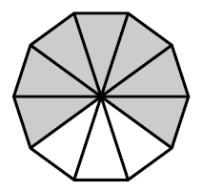
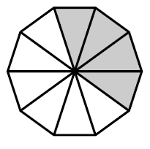
Find the difference.
Identify and write the fractions.
Count the sections of the smaller fraction
Mark an X on each section of the larger fraction to show how many you will subtract.
Count the shaded sections that you have left—this is the numerator of the difference.
x
x
1
2
x
3
7
10
x
4
4
10
3
10
=
-

Slide 5
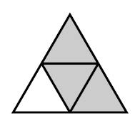
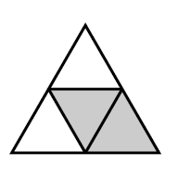
Find the difference.

Slide 6
What is the sum of these fractions?
If you fill in this shape, you have
5 out of 5 or ONE
and one fifth left in the other fraction.
1
5
2
5
4
5
+
1
=

Slide 7
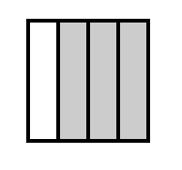
What is the sum of these fractions?
3
4
3
4
+

Slide 8
What is the sum of these fractions?
If you fill in this shape, you have
4 out of 4 or ONE
and two fourths left in the other fraction.
3
4
3
4
2
4
=
+
1

Slide 9
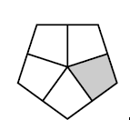
What is the sum of these fractions?

Slide 10
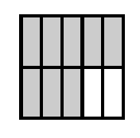
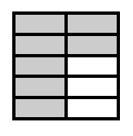
Find the difference.

Slide 11
What is the sum of these fractions?
2
5
3
5
1
5
=
+

Slide 12
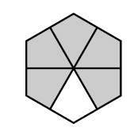
Find the difference.

Slide 13
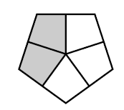
Which two fractions have a sum of 1?
A
B
C
D
Explain how to solve this problem?

Slide 14
4
5
Which two fractions add to ?
A
B
C
D
Explain how to solve this problem?

Slide 15
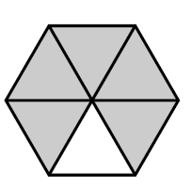
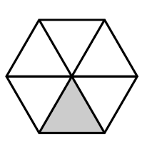
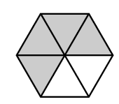
Which two fractions
could you add together
to get more than one?
A
B
C

Slide 16
Which fraction is
shaded to show a fraction
that is more than half?
Explain your answer?

Slide 17
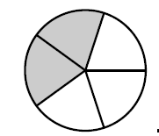
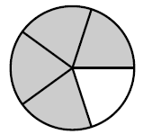
What is the sum of these fractions?

Slide 18
Find the difference.

Slide 19
Which fraction is
shaded to show one half?
Explain your answer?

Slide 20
Which two fractions have a sum of 1?
A
B
C
Explain how to solve this problem?

Slide 21
Which fraction is
shaded to show a fraction
that is less than half?
Explain your answer?

Slide 22
What is the sum of these fractions?

Slide 23
Will the sum of these two fractions
be more than one or less than one?
What will be the sum?

Slide 24
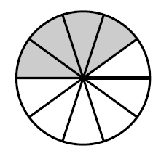
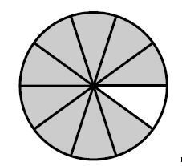
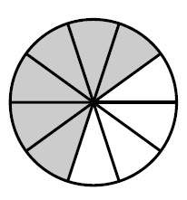
Which two fractions have a sum of 1?
Explain how to solve this problem?

Slide 25
What is the sum of these fractions?

Slide 26
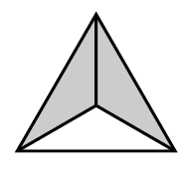
What is the sum of these fractions?

Slide 27
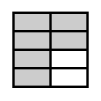
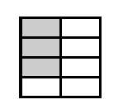
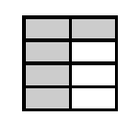
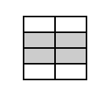
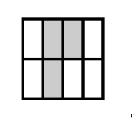
A
B
C
F
D
E

Slide 28
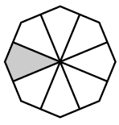
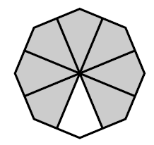
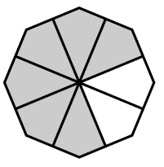
Which two fractions
add to ?
5
8
1

Slide 29
Find the difference.

