Slide 1
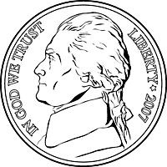
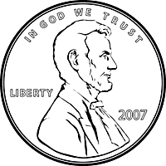
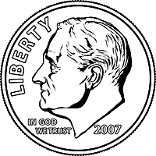
Counting & Comparing
Money
$
$
$
$

Slide 2
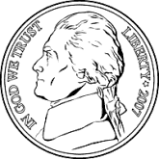
A. Set A is less than Set B
B. Set A is greater than Set B.
C. Set A is equal to Set B

Slide 3
A. Set A is less than Set B
B. Set A is greater than Set B.
C. Set A is equal to Set B

Slide 4
A. Set A is less than Set B
B. Set A is greater than Set B.
C. Set A is equal to Set B

Slide 5
A. Set A is less than Set B
B. Set A is greater than Set B.
C. Set A is equal to Set B

Slide 6
A. Set A is less than Set B
B. Set A is greater than Set B.
C. Set A is equal to Set B

Slide 7
A. Set A is less than Set B
B. Set A is greater than Set B.
C. Set A is equal to Set B

Slide 8
A. Set A is less than Set B
B. Set A is greater than Set B.
C. Set A is equal to Set B

Slide 9
A. Set A is less than Set B
B. Set A is greater than Set B.
C. Set A is equal to Set B

Slide 10
A. Set A is less than Set B
B. Set A is greater than Set B.
C. Set A is equal to Set B

Slide 11
A. Set A is less than Set B
B. Set A is greater than Set B.
C. Set A is equal to Set B

