Slide 1
Modeling Equations

Slide 2
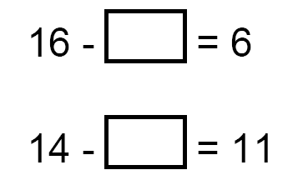
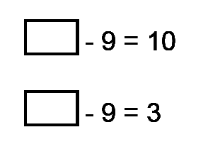
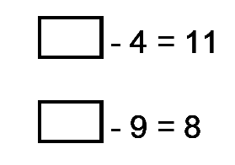

Slide 3
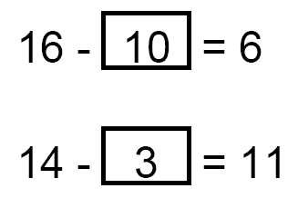
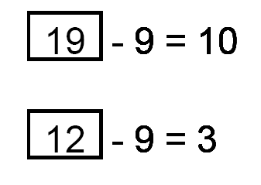
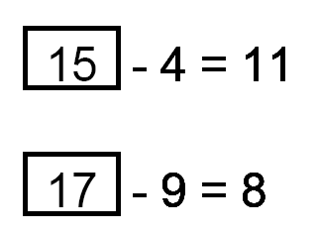

Slide 4
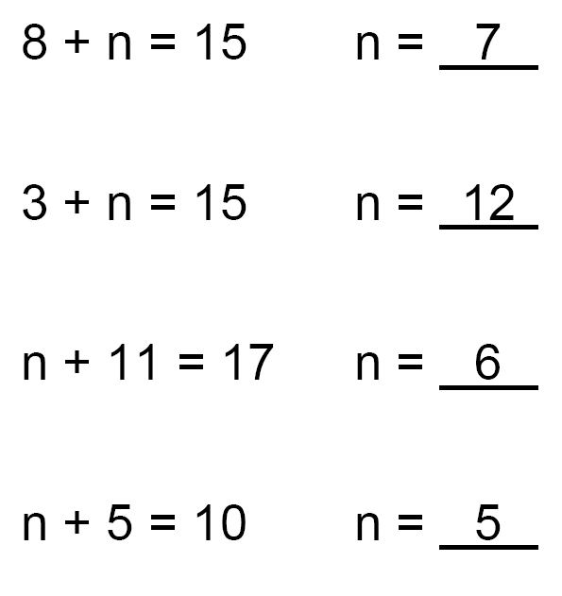
What is
the value of
n
in each equation?
?
?
?
?

Slide 5
8 + 7 = 15
3 + 12 = 15
6 + 11 = 17
5 + 7 = 15

Slide 6
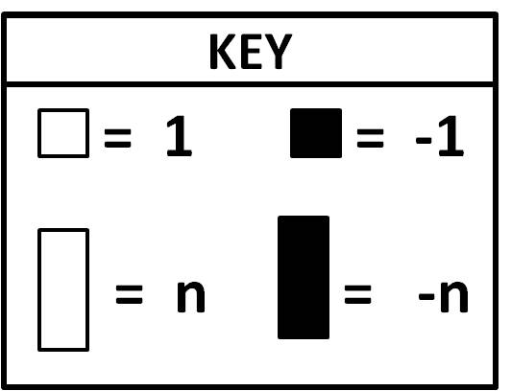
Modeling Equations
KEY
= 1
= - 1
= n
= - n

Slide 7
n + 4 = 7
3
=
n = 3 because
3 + 4 = 7

Slide 8
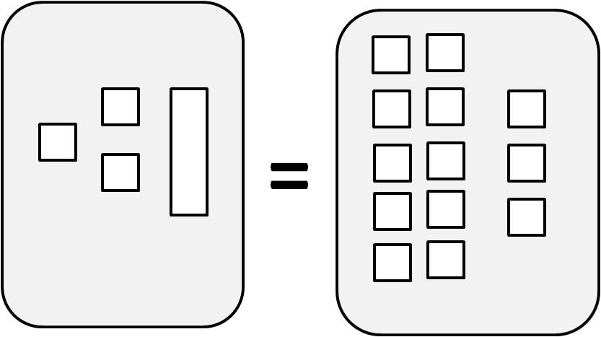
3 + 10 = 13
10
=
n = 10 because
3 + 10 = 13

Slide 9
n - 4 = 7
11
=
n = 11 because
11 – 4 = 7

Slide 10
n - 2 = 7
9
=
n = 9 because
9 – 2 = 7

Slide 11
n - 9 = 10
19
=
n = 19 because
19 – 9 = 10

Slide 12
7 - 1 = 6
7
=
n = 7 because
7 – 1 = 6

Slide 13
16 – n = 12
=
4
n = 4 because
16 – 4 = 12

Slide 14
6 + n = 14
8
=
n = 8 because
6 + 8 = 14

Slide 15
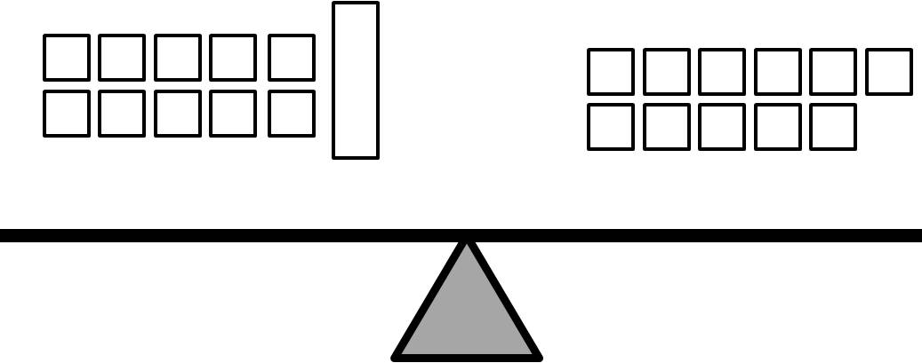
10 + n = 11
1
=
n = 1 because
10 + 1 = 11

Slide 16
9 – n = 8
=
1
n = 1 because
9 – 1 = 8

Slide 17
2 + n = 7
=
11
n = 5
because
2 + 5 = 7

Slide 18
4 + n = 13
=
9
=
n = 9 because
4 + 9 = 13

